Slide 1

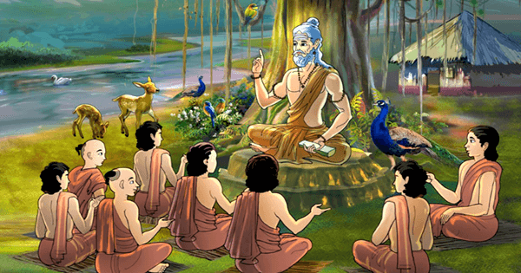
Gurukul Learning:
Ancient Method meeting Modern Day
Team Id: H26EDU03
Team Lead: Nagella Venkata Siva
Sai Advik
Team Members: Barath Kumar S
Collage Name: Kumaraguru Collage of Technology

Slide 2



Problem Definition & Its Significance
Historically, high-quality, 1-on-1 tutoring is an exclusive privilege.
Mass education systems face impossible student-to-teacher ratios.
Result: Millions fall behind in foundational logic, literacy, and numeracy.
Objective:
Democratize elite-level, personalized mentorship at consumer scale.
Approach:
Build a multi-agent AI tutor that dynamically adapts its teaching metaphor, regional dialect, and difficulty based on the learner's age and passions.

Slide 3


Literature Survey & The Gap
Existing EdTech AI acts like a rigid encyclopedia. It hallucinates and lacks emotional intelligence.
Great teachers use regional dialects, local culture, and students' personal interests to make learning more relatable and effective.
Current AI fails to replicate this human connection.
Current Gap:
Adaptive Persona & Tone: Missing in current solutions.
Regional Dialect/Idioms: Missing in current solutions
Non-linear Fallback Routing: Missing (Standard AI just repeats "Try Again").

Slide 4

Gemini API
System Architecture
Personalized Audio/Presentation
(Add-On)
Multi - Agent API Model
Phase A : Context Taker
Phase B: Learning Loop
Backend Server (State and Routing Managet)
Relevancy and Rule Evaluvator
Learner UI(Web/Mobile Interface)
Agent for Voice
(Add-On)
Database
Phase A
GET /api/onboard
POST /api/onboard/submit
Phase B
POST /api/learn/start
POST /api/learn/generate
GET /api/learn/stream
PATCH /api/learn/evaluate
Knowledge Tester
(Add-On)

Slide 5

Current Development & Preliminary Results
Frontend:Still need to start on building
Backend: Django server with LearnerProfile and MistakeLog models.
Multi-Agent AI: NVIDIA Llama 3.1 + Gemini APIs integrated and working together.
Adaptive Learning: AI personalizes lessons.
Current Status: Core AI pipeline is fully functional; integrating with Django frontend.

Slide 6


